Slide 1


PITHIA-NRF STIM model Rest API
Dimitris Kagialis – University of Westminster
13.06.2022

Slide 2
STIM Scientific Purpose
DSCOVR
MAG Source
5m
5m
1m res
RT JSON
The National Observatory of Athens (NOA) has built a solar wind-driven empirical model for the middle latitude ionospheric storm-time response, namely the storm-time ionospheric model (STIM).
The model is configured to collect data from the ACE satellite, process them, and save them in a database.
2h
2h
HTTP
6h
Prioritize
Ingestion Engine
6h
Aggregate/
Homogenize
1d
1d
Trigger
Store
3d
3d
7d
Iono. Storm
Procedure
Plasma Source
7d
1h data
Apply
model
ACE
MAG Source
1m data
2h
Store
Storms
2h
FTP
1m/1h res
Archive ASCII
1d
1d
Plasma Source

Slide 3
STIM Functionalities
To user can interact with the model in three ways:
Execute the model to collect new data
Query the database for specific scientific values
Plot an image with solar storms during a specific period

Slide 4
Previous work - STIM Reference Architecture
STIM Reference Architecture
External Service
JupyterHub
Notebook Server
NFS
Initiate
Store data
Log in
SSH
Query
The model has been extending so to offer those three functionalities along with other technical advancements as a result of the EU funded project Pithia-NRF.
That work has been described in the publication:
https://doi.org/10.1002/cpe.6872
Persistent Volume
STIM model
MySQL
MiCADO Workers
Deploy the architecture
Monitor status
Guarantee liveness
MiCADO Master

Slide 5
Current work - STIM Rest API
STIM Rest API
External Service
Rest API
1 Request/Response
2 Request/
Response
The model has been extending so to offer the three functionalities through a Rest API. That API enables the model to be consumed by external services.
The process goes as follow:
The external service sends a request to the exposed Rest API.
The Rest API initiates the Model’s source code to perform the requested operation.
Model’s Source Code perform the required Data Operations and Send the results back to the External Service.
Models Source Code
MySQL
3 Data Operations
MSQL server
container
STIM model
container
STIM microservices architecture

Slide 6
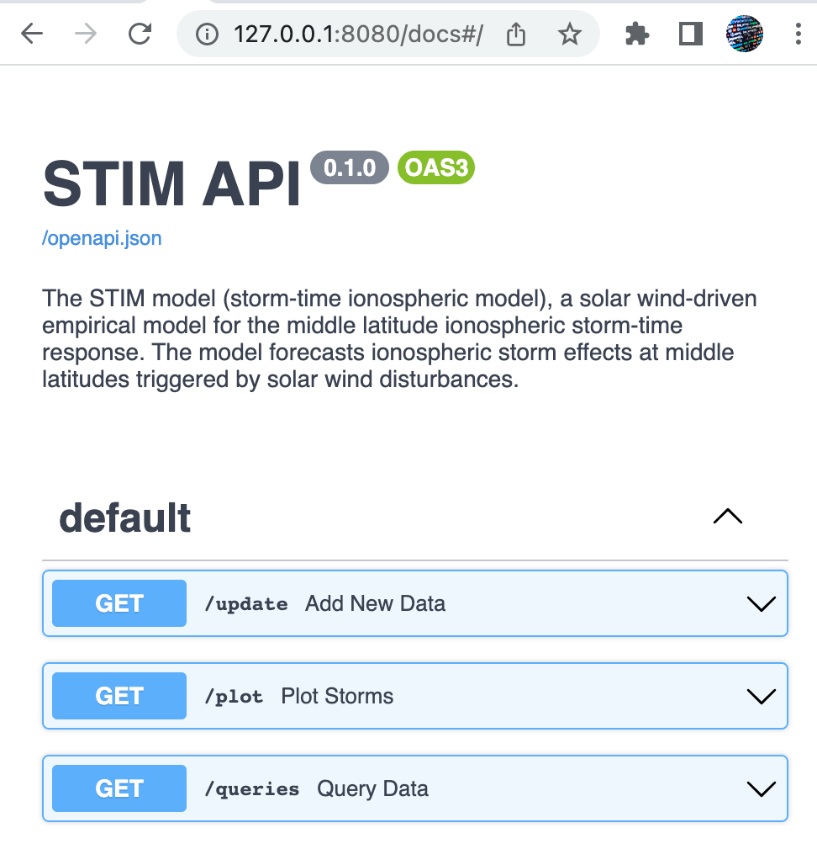
STIM Rest API - Demo
The API expose the three functionalities to three different endpoints:
Update the model
Plot storms
Query Data

Slide 7
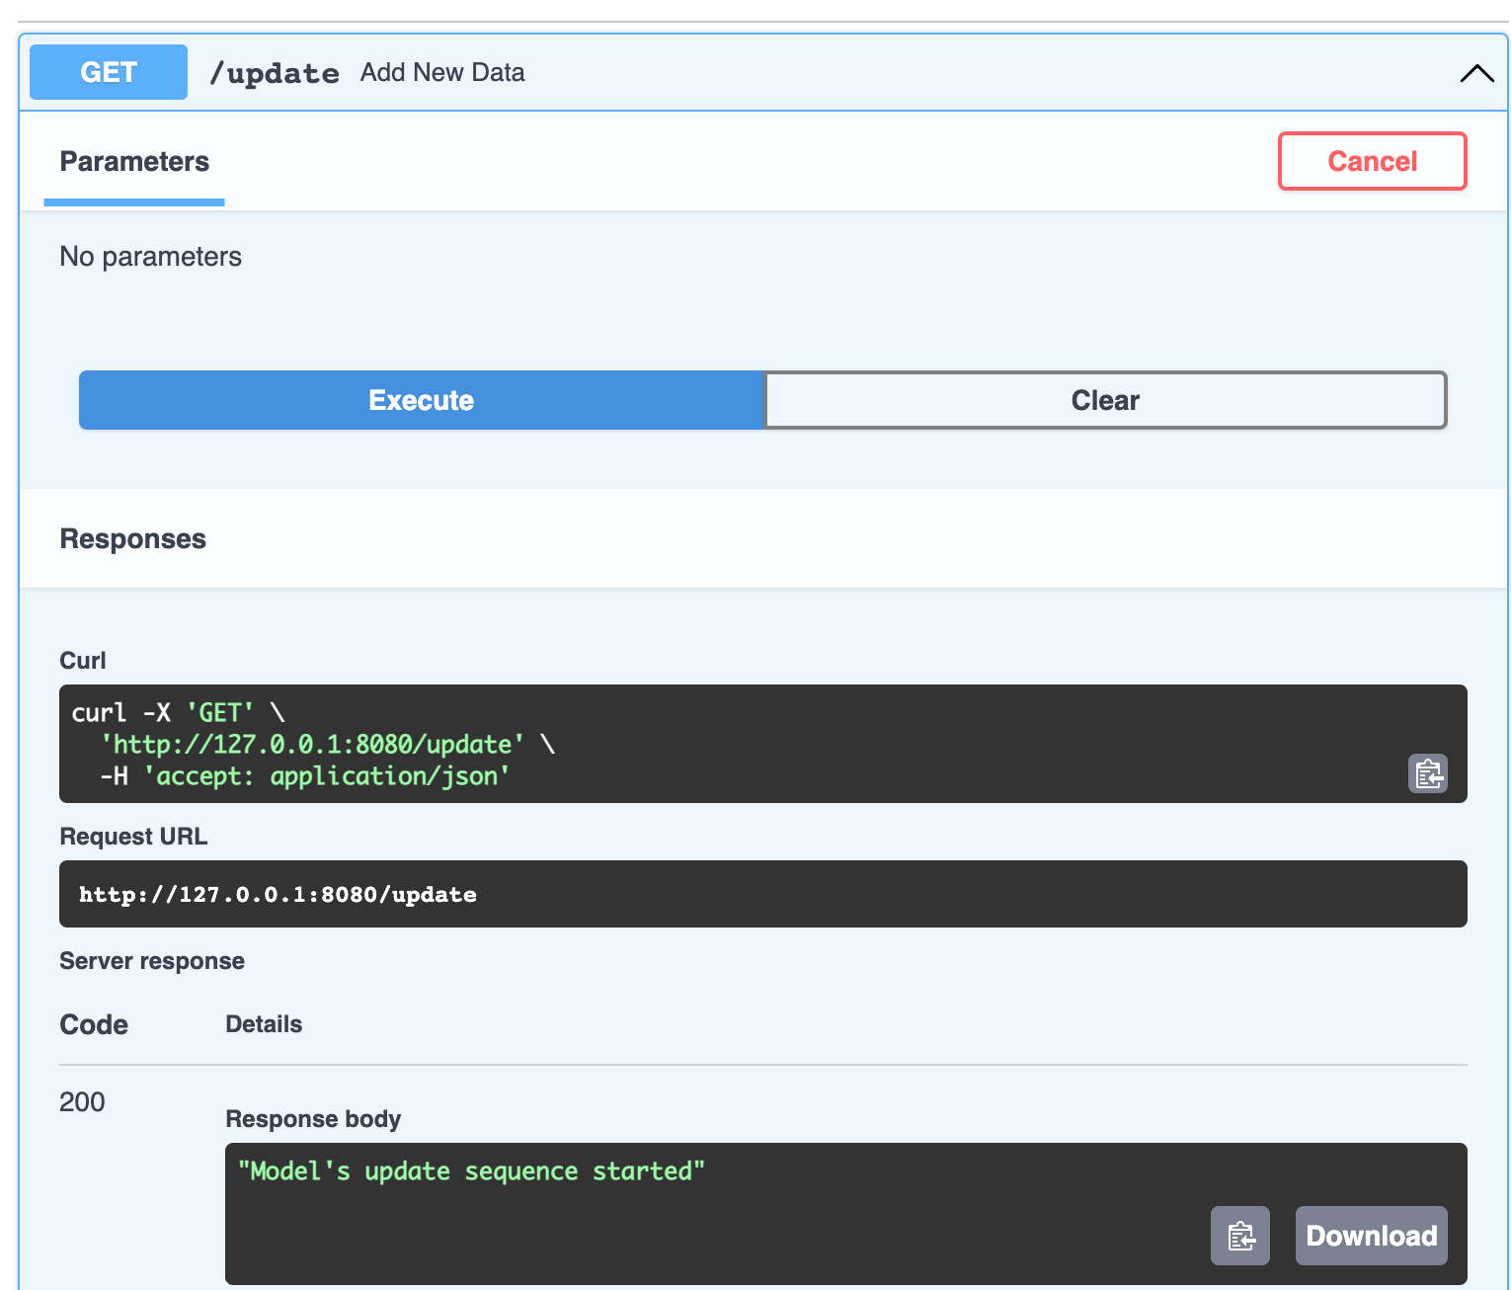
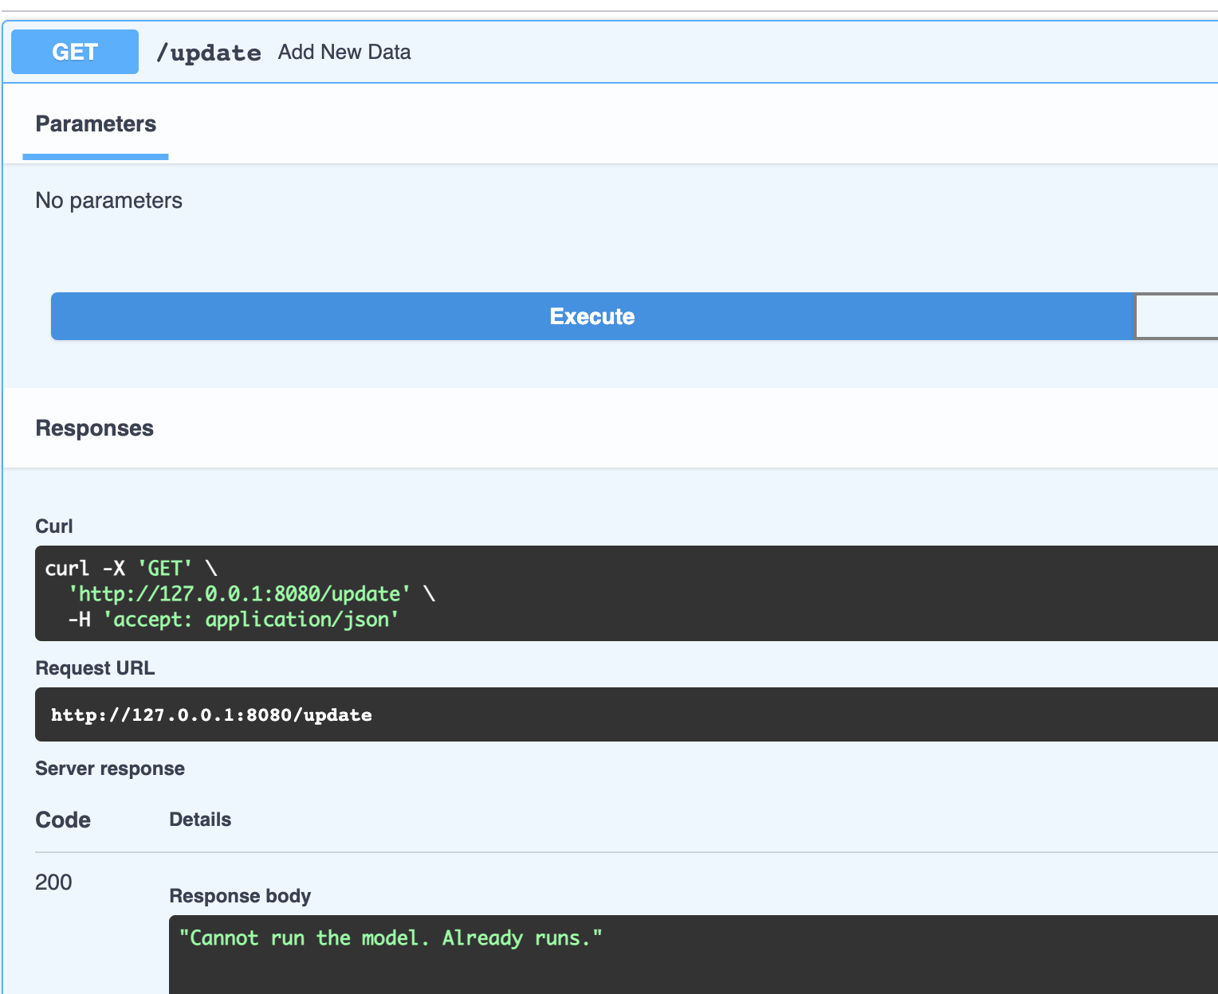
STIM Rest API – Demo – Update Model
Model runs as a single user application. For this reason only one user can execute it each time. Wherever someone selects to update the model, she/he can get a successful (Figure A) or an unsuccessful (Figure B) response.
Figure A – Successful update request/response
Figure B – Unsuccessful update request/response

Slide 8
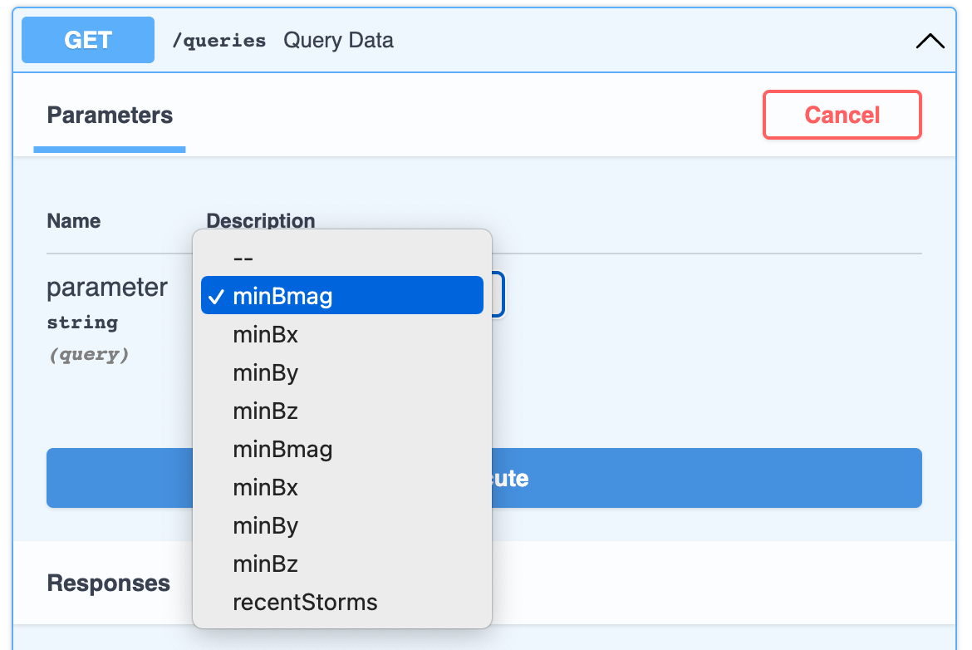
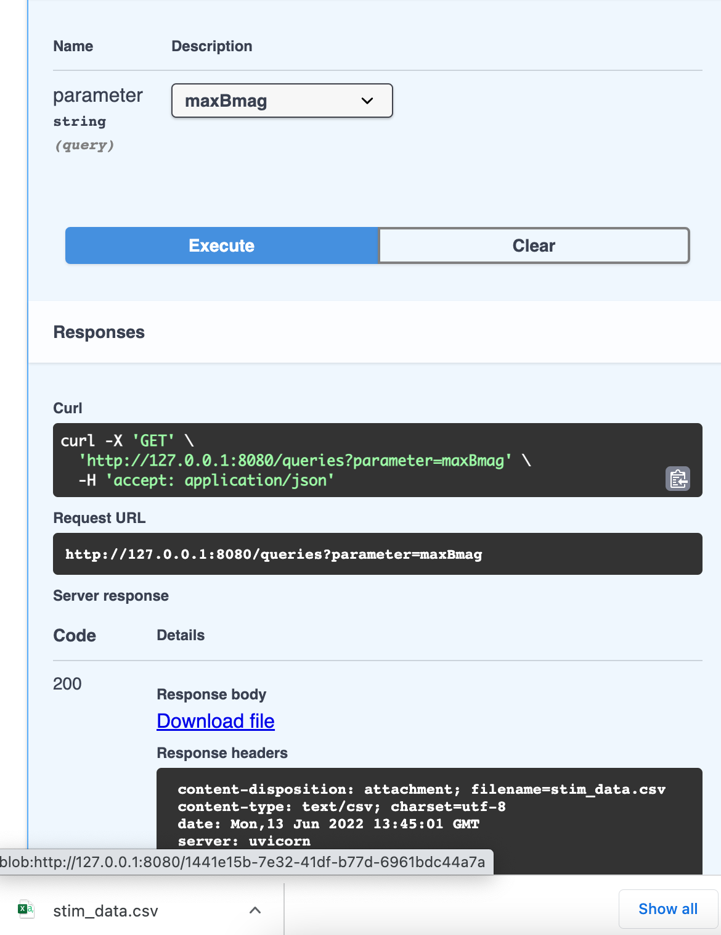
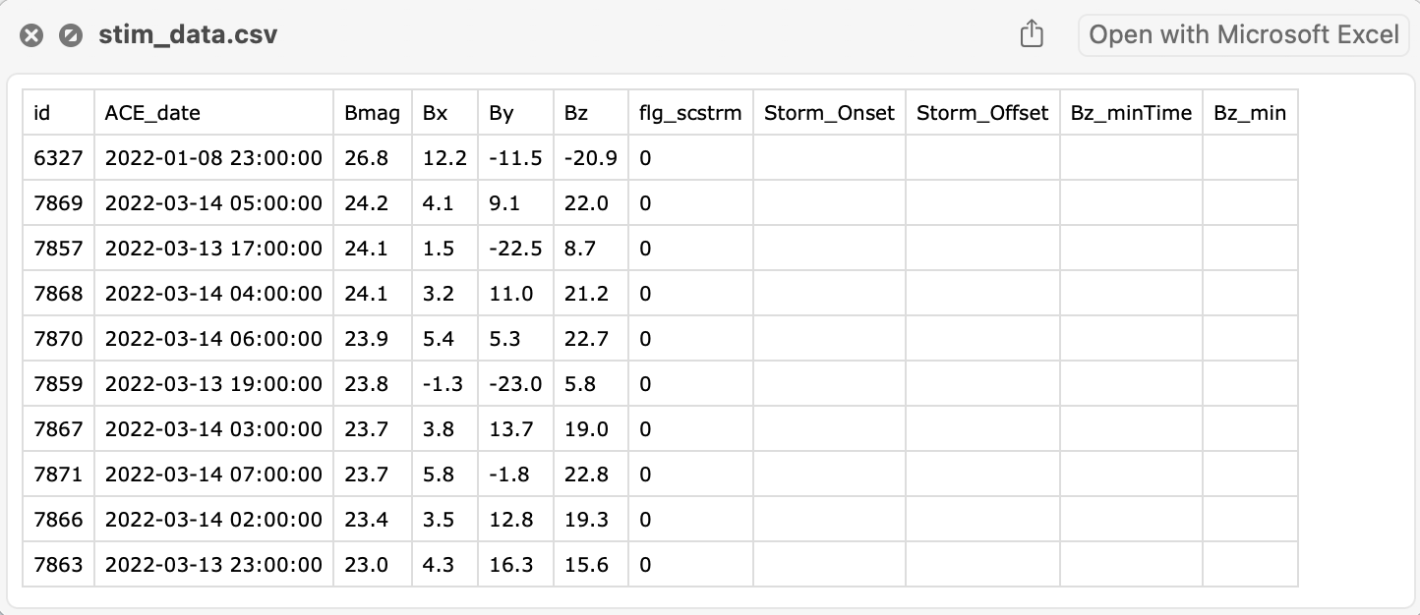
STIM Rest API – Demo – Query Data
Wherever someone selects to query the model for data, she/he can choose between the available data offered by the model (Figure A) and send the request. The Rest API talks to the model, which collects the data and returns a csv file (figure B).
Figure A – Select Data request
Figure B – Select Data response

Slide 9
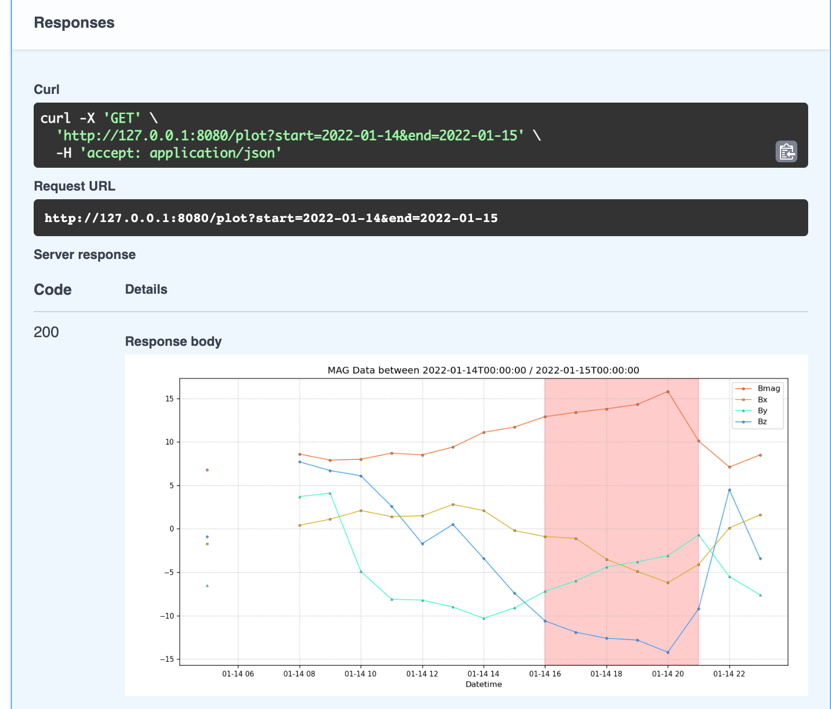
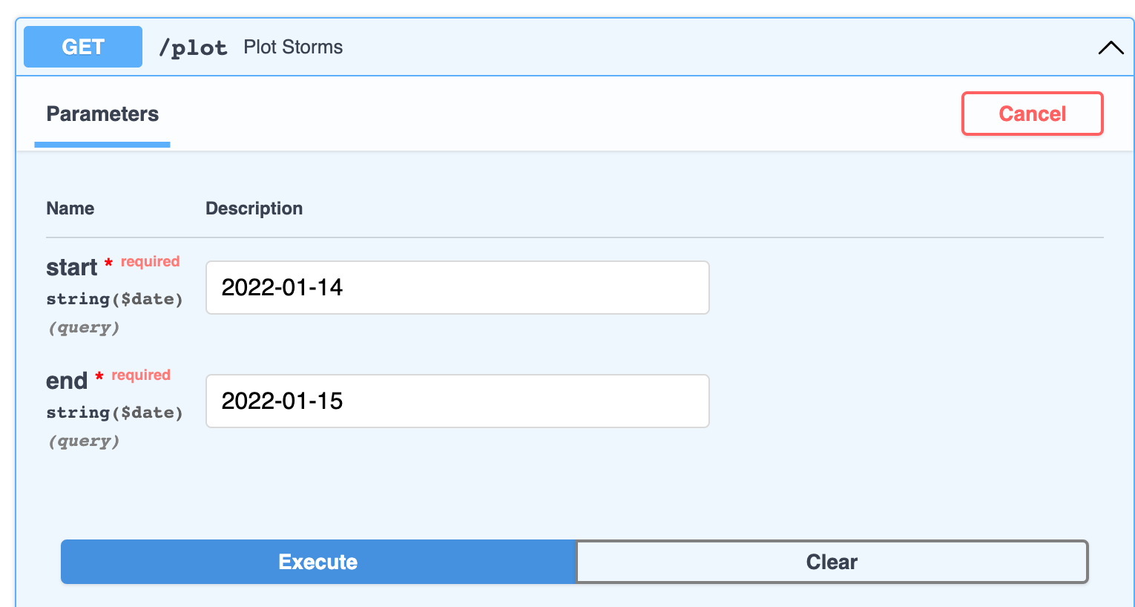
STIM Rest API – Plot Storms
Wherever someone selects to plot storms, she/he can specify a time period so to create a plot (Figure A) and send the request. The Rest API talks to the model, which creates the plot and returns a figure (figure B).
Figure A – Plot Storms request
Figure B – Plot Storms response

